Slide 1
Membership: A Renewable Resource

Slide 2
American Society of Agronomy
Crop Science Society of America
Soil Science Society of America
Three autonomous Societies, united together, by a shared commitment to the conservation and wise use of natural resources to produce food, feed, fiber, forage , and pharmaceutical crops while maintaining and improving the environment through wise land management.

Slide 3
American Society of Agronomy
Agronomy Feeds the World
7,600+ members and 12,000+ certified (CCA, CPAg)
16% international membership
Founded in 1907
www.agronomy.org
Notes:
Students (Undergrad & Grad), Professionals, Emeritus, Corporations
19% employed by Industry, 31% by Academia, 12% by Governments (remaining are students, other employers, unknown)
Headquarters in Madison, WI with a Science Policy Office in Washington, DC
45 staff (shared with CSSA and SSSA)

Slide 4
Crop Science Society of America
Plant Science for a Better World
5,300+ members
17% International
Founded in 1955
www.crops.org
Notes:
Students (Undergrad & Grad), Professionals, Emeritus, Corporations
16% employed by Industry, 30% by Academia, 10% by governments (remaining are students, other employers)
Headquarters in Madison, WI, with a Science Policy Office in Washington, DC
45 staff (shared with ASA and SSSA)

Slide 5
Soil Science Society of America
Soils Sustain Life
6,400+ members
19% International
Founded in 1936
www.soils.org
Notes:
Students (Undergrad & Grad), Professionals, Emeritus, Corporations
13% employed by Industry, 34% by Academia, 15% by governments (remaining are students, other employers, unknown)
Headquarters in Madison, WI, with a Science Policy Office in Washington, DC
45 staff (shared with ASA and CSSA)

Slide 6
The Value of Membership
Publishing Research
Annual and Branch Meetings
Communities (ASA)/Divisions of Interest (CSSA, SSSA)
Career Resources
Certification
Electronic Communications
Leadership Opportunities
Informing Science Policy/Public Information
Notes:
Talk about the value of membership to you personally.

Slide 7
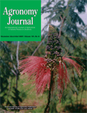
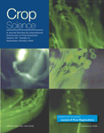
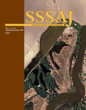
Publications
Flagship Journals
Agronomy Journal
Crop Science
Soil Science Society of America Journal
Complementary Journals
Journal of Environmental Quality
Journal of Natural Resources and Life Sciences
Education
Vadose Zone Journal
Journal of Plant Registrations
The Plant Genome

Slide 8
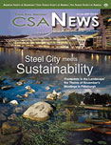
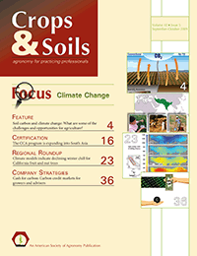
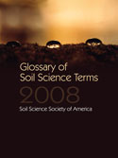
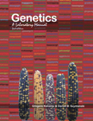
Publications
Magazines
CSA News
Crops and Soils
Soil Horizons (electronic)
Books
Custom Content
Notes:
CSANews is a members-only magazine of ASA, CSSA, and SSSA.
Each month features:
News about Society members,
Research Highlights that have been published in Society journals,
International issues,
Information on the Annual Meetings and symposia
Job Listings
Science Policy News
and other up-to-date information.
Crops and Soils is sent to all ASA and SSSA certificants
Membership receive significant discounts on Society journals in a variety of media (print, online, CD) and a 20% discount on books and monographs.

Slide 9
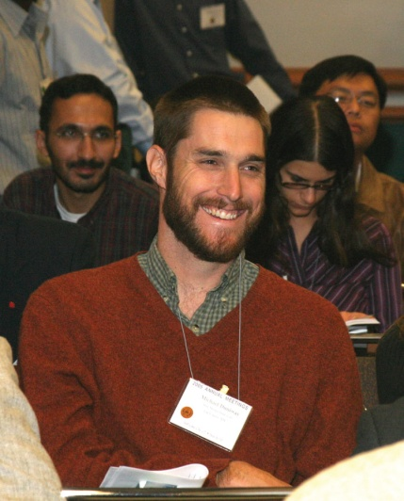
International Meetings
ASA, CSSA, SSSA Annual Meetings
Cincinnati, OH - Oct. 21-24, 2012
Keynote Speakers & Symposia
Plenary Sessions
Hot Topics, Cutting-Edge Research, Social Opportunities
Student Programs – SASES Undergraduate Program, Golden Opportunity Scholars Institute
Notes:
This is the flagship event for the three Societies. The typical timeline is:
Abstracts are submitted in Spring
Program is developed in Spring/Summer
Registration opens in July
Meetings are held in late October/Early November
Features are:
Society-specific Plenary Sessions
Division Symposia
2500 Oral and Poster Presentations (which may be recorded with your permission)
Social Gatherings
Student Competitions
Most Valued and Important – Networking! Meeting colleagues old and new!
www.acsmeetings.org

Slide 10
ASA Sections
Agronomic Production Systems
Biometry & Statistical Computing
Climatology & Modeling
Education & Extension
Environmental Quality
Global Agronomy
Land Management & Conservation
Currently there are 39 Communities within the Sections
Notes:
Each of the divisions hosts symposia and sponsors poster and oral presentations related to their scientific areas, at the Annual Meetings. They also have individual websites, listservs, awards, and more.
The divisions provide a great opportunity to connect with other members in similar areas.
ASA is currently reviewing its division structure, looking to provide more flexibility and ease of forming and disbanding groups as member needs change.

Slide 11
CSSA Divisions of Interest
Biomedical, Health-Beneficial, and Nutritionally Enhanced Plants
Crop Breeding and Genetics
Crop Ecology, Management & Quality
Crop Physiology and Metabolism
Forage & Grazinglands
Genomics, Molecular Genetics, and Biotechnology
Plant Genetic Resources
Seed Physiology, Production, & Technology
Turfgrass Science
Notes:
Each of the divisions hosts symposia and sponsors poster and oral presentations related to their scientific areas, at the Annual Meetings. They also have individual websites, listservs, awards, and more.
The divisions provide a great opportunity to connect with other members in similar areas.

Slide 12
SSSA Divisions of Interest
Forest, Range, and Wildland Soils
Nutrient Management & Soil and Plant Analysis
Pedology
Soil/Water Management & Conservation
Biology & Biochemistry
Soil Chemistry
Soils & Environmental Quality
Fertility & Plant Nutrition
Soil Mineralogy
Soil Physics
Wetland Soils
Consulting Soil Scientists
Notes:
Each of the divisions hosts symposia and sponsors poster and oral presentations related to their scientific areas, at the Annual Meetings. They also have individual websites, listservs, awards, and more.
The divisions provide a great opportunity to connect with other members in similar areas.

Slide 13
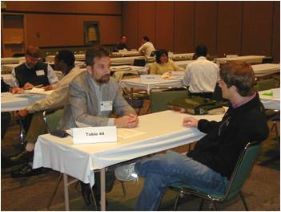
Explore Job Opportunities
Free Resume Posting for members
Job Postings by Employers
Online job and graduate school postings at the Annual Meetings
Annual Meeting job interviews at the Career Placement Center
Notes:
The Career Placement Center functions to promote career opportunities and serves to connect job seekers and employers.
Members can post resumes free of charge and have them searched by employers online.
They also receive one free personnel ad in the Positions Wanted category in CSANews.
The Service offers interview sessions for jobs and graduate school at their Annual Meetings.
Job postings may be published monthly in CSANews and are updated daily online.
Career Services Information is at:
www.careerplacement.org

Slide 14
Career Resources and Awards
Over $225,000 in Awards, Scholarships and Fellowships
Golden Opportunity Scholars
Internships
Communications (Headquarters)
Online Career Resources and Tools
Notes:
Each year, the Societies jointly and individually offers numerous awards, scholarships, fellowships, and fellow awards.
For graduate students there are fellowships available. In addition, the Societies offer a Science Policy Internship and Congressional Science Fellow positions in Washington, DC
The award and fellow nominations are typically submitted early in the calendar year and generally require letters of reference.
The Golden Opportunity Scholars Institute,matches undergraduates with scientist-mentors during the ASA–CSSA–SSSA International Annual Meetings. The program encourages talented students to enter the crop sciences, cultivate networks, and succeed in their career. In each of the past three years, 14-15 undergraduate scholars have been selected based on their academic achievements and interest in agronomy, crop, or soil science. The program provides financial support for travel, lodging,
registration, and other costs related to attending the Annual Meetings. Student scholars are introduced to their mentor at the beginning of the Annual Meetings and also acknowledged at an Awards Program. Students from all over the U.S. and the world will be selected. Beginning each year at the CSSA Annual Meetings, student scholars will:
• Participate in the Golden Opportunity Scholars Institute
• Engage in one-on-one activities with mentors
• Listen to presentations from high-profile scientists
• Gain exposure to many disciplines in agronom, crop, and soil science
• Attend undergraduate student programs
• Be recognized during an Awards Program
• Participate in year-round mentoring
Awards information can be found at:
www.agronomy.org/awards
www.crops.org/awards
www.soils.org/awards

Slide 15
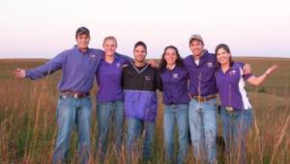
Student Activities
Students of Agronomy, Soils, and Environmental Sciences – 400+ members
Annual Meeting Program
Poster and Oral Competitions
Student Leadership
Golden Opportunity Scholars Program
Graduate Students – 1400+ members
Sub-Committee of Membership Committee
Annual Meetings – division student competitions
Branch Meetings – student competitions-oral & poster
Awards (fellowships, internships, etc.)
Notes:
Student of Agronomy, Soils, and Environmental Sciences = SASES – and is the undergraduate student program of ASA, CSSA, and SSSA. It is composed of chapters located at colleges and universities that provide a curriculum in agronomy, crops, soils and environmental sciences. A variety of programs and activities are offered on the local and national level for students to become professionally involved and to prepare for their future careers.
SASES is governed by a five member student executive committee, elected each year during the annual meetings. This committee and a faculty advisor, plan sand coordinates the annual meeting program.
Students can participate in a variety of activities such as the Manuscript, Speech, Research Symposium, Visual Presentation, Club Poster, Soil and Crops Judging Contests. An annual program call National Student Recognition Program recognizes outstanding seniors in agronomy, crop, soil and environmental science departments. The SASES has there own annual meeting program in conjunction with the annual meetings of ASA, CSSA and SSSA. This a 3 ½ day event that includes business meetings, contests, tours, professional development programs and socials.
Graduate Students can participate in a variety of activities such as:
Division competitions at the Annual Meetings
Several fellowships are available
Regional Branch Meetings offer an opportunity to present and compete
Serve on national Society Committees
Grad student only Social and Lounge at the Annual Meetings

Slide 16
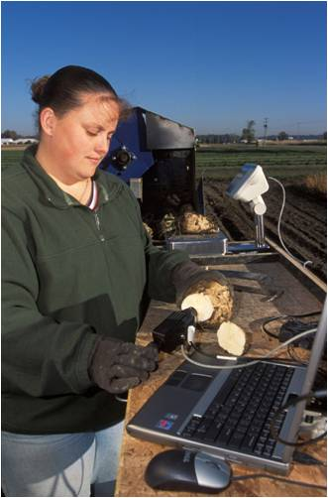
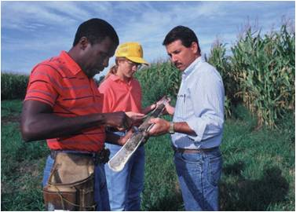
Certification
The benchmark of professionalism and a voluntary
professional enhancement to a person's career
credentials. Certification tells clients, employers,
and the public that you are serious about what you
do as a professional.
Certified Crop Advisor (CCA)
US, Canada, India, Mexico (starting 2012)
Future Locations: Argentina
Certified Professional Agronomist (CPAg) – a specialty of the CCA program
Certified Professional Soil Scientist (CPSS)
Notes:
12,000 CCAs, 800 CPAgs
800+ CPSS/CPSC
Components of Certification include:
Education
Work Experience
Examination
Certification programs from ASA are the benchmark of professionalism. The purpose of a certification program is to protect the public and the profession. The same is true of our certifications. They are voluntary professional enhancements to a person's career credentials. Once certified you are telling your clients, employer, and the public that you are serious about what you do as a professional.
Complete information is available at: www.agronomy.org/certifications or www.soils.org/certifications
ASA is developing a program for CCA certification in India – to launch sometime in 2010.

Slide 17
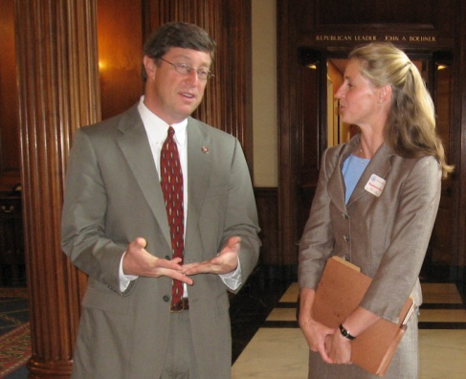
Science Policy Efforts
Congressional Visit Days
Congressional Soils Caucus (SSSA)
Core constituent Scientist Teams
Congressional Science Fellows
Interns
Current Issues: climate change, C sequestration, environment, energy, agroecosystems, frontier science, global hunger …

Slide 18
Informing Science Policy
Congress
White House (OSTP, PCAST)
Agencies (USDA, USGS, EPA, NSF, NASA, NOAA, DOE, DOD)
Seek federal funding for agronomic, crop and soil sciences
Advocate for our sciences funded through USDA, NSF, DOE, NASA, NOAA and other agencies
Coalitions, Commodity Groups, etc.
Notes:
The Science Policy office is located in Washington, DC.
There are two full time staff and 1-2 interns.
They monitor legislation, advocate for funding on behalf of the membership, connect scientists with staffers to serve as a resource.
They will also work with members to arrange visits with their legislators.

Slide 19
Member Benefits
Monthly CSA News magazine
Discounts on subscriptions and books
Access to the Membership Directory
Access to the Scientific Expertise Directory
Biweekly e-newsletters – Newsflash and Science Policy Report
Opportunity to present poster and oral papers in divisions at the Annual Meetings
Free online posting of your resume
Membership in Communities/Divisions of Interest (in those Societies in which you hold membership)
Discounts on meeting registrations
Notes:
CSA News is provided in both print and online (online only for undergrads).
Discounts of 20% are available on books. Subscription discounts are up to 80% of the library rate.
Through the Membership Directory, you can search for members by geographic region, by Society membership, and divisions of interest.
Through the Scientific Expertise Directory, members can post their areas of expertise and be listed for the public, media and other members to make contact.
The bi-weekly Newsflash provides deadline specific information from the Societies and related affiliate organizations. The bi-weekly Science Policy Report provides updates on legislation and grants.

Slide 20
Member Opportunities
Awards, Scholarships, Fellowships
Volunteer for Society Activities
Participate in Science Policy Activities
Supporting the Profession & K-12 Activities
Notes:
Annually, a call for volunteers is sent out to members to request committee appointments. This generally occurs in late Spring with appointments made in August – December for the following calendar year.
The compensation survey is new for 2010 – members can participate and receive a snapshot of salaries and full reports are available at discounted prices.
Membership also supports the professions – through K-12 outreach, science communications, support for the Science Policy office and more. The larger the membership, the stronger our voice is.

Slide 21
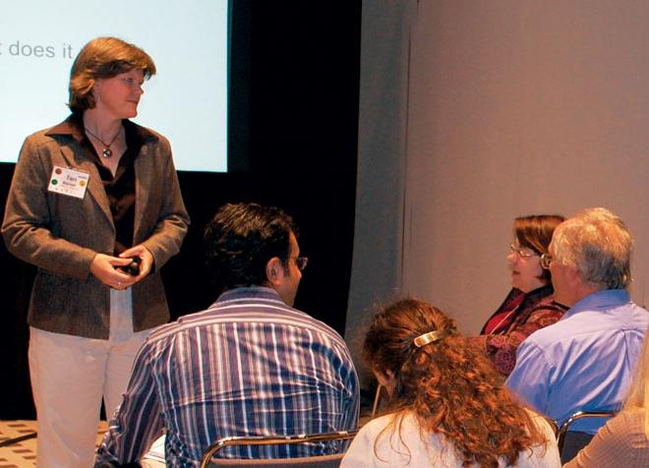
Leadership Opportunities
Committees
Task Forces
Divisions
Editorial Boards
Boards of Directors
Leadership Development Workshops

Slide 22
I am trying to do anything that I can to give back to the Societies because the Societies have helped my career a lot. I present research at meetings, write in the journals, review manuscripts and participate on several committees.
Palle Pedersen
Syngenta

Slide 23
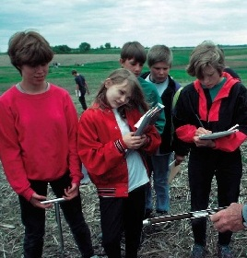
Support the Professions
SSSA K-12 Committee
(www.soils.org/lessons)
Teacher Resources
Book Development
Curricula and Workshop Development
ASA and CSSA K-12 Committees are developing information

Slide 24
Social Media
Twitter | @ASA_CSSA_SSSA and @SSSA_Soils
RSS Feeds | www.agronomy.org/rss, www.crops.org/rss, www.soils.org/rss
Facebook | ASA.agronomy, CSSA.crops, SSSA.soils., SASES.students

Slide 25
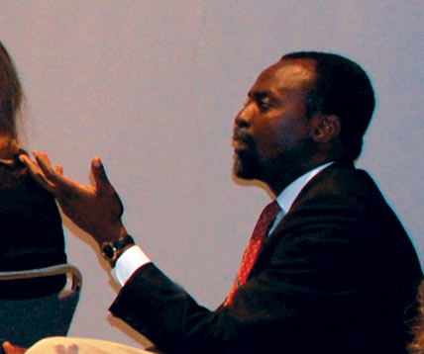
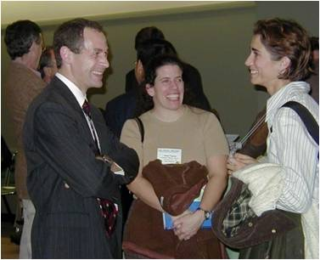
So … Get Involved
Join the Societies
Meeting new people
Broaden professional contacts
Become professionally involved
Find a new position
Advance your career
Learn new skills

Slide 26
Thank You!
www.agronomy.org
www.crops.org
www.soils.org

